Slide 1
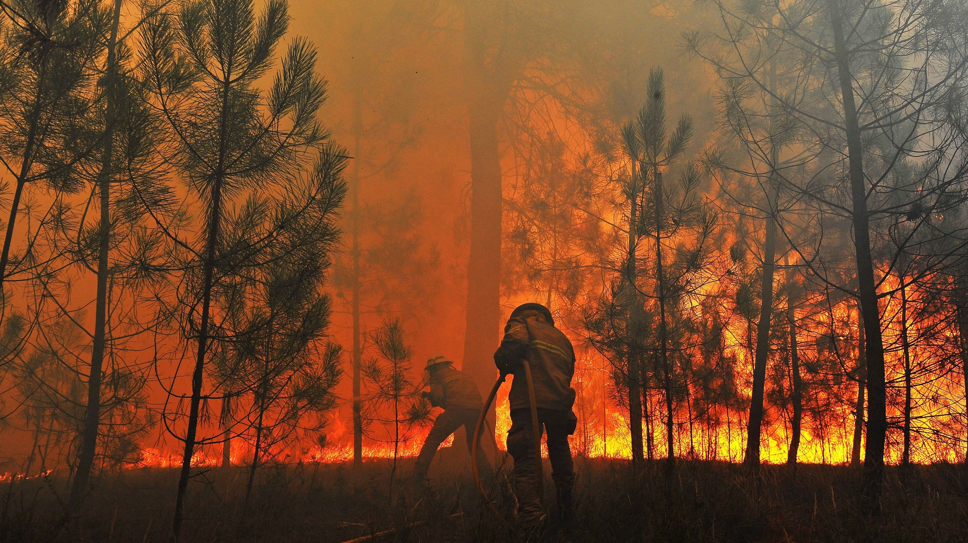
The fires in Portugal
Simão Lopes, 2022

Slide 2
The problem
Is it possible to predict the amount of burnt area from the available information and use it to optimize resources?

Slide 3
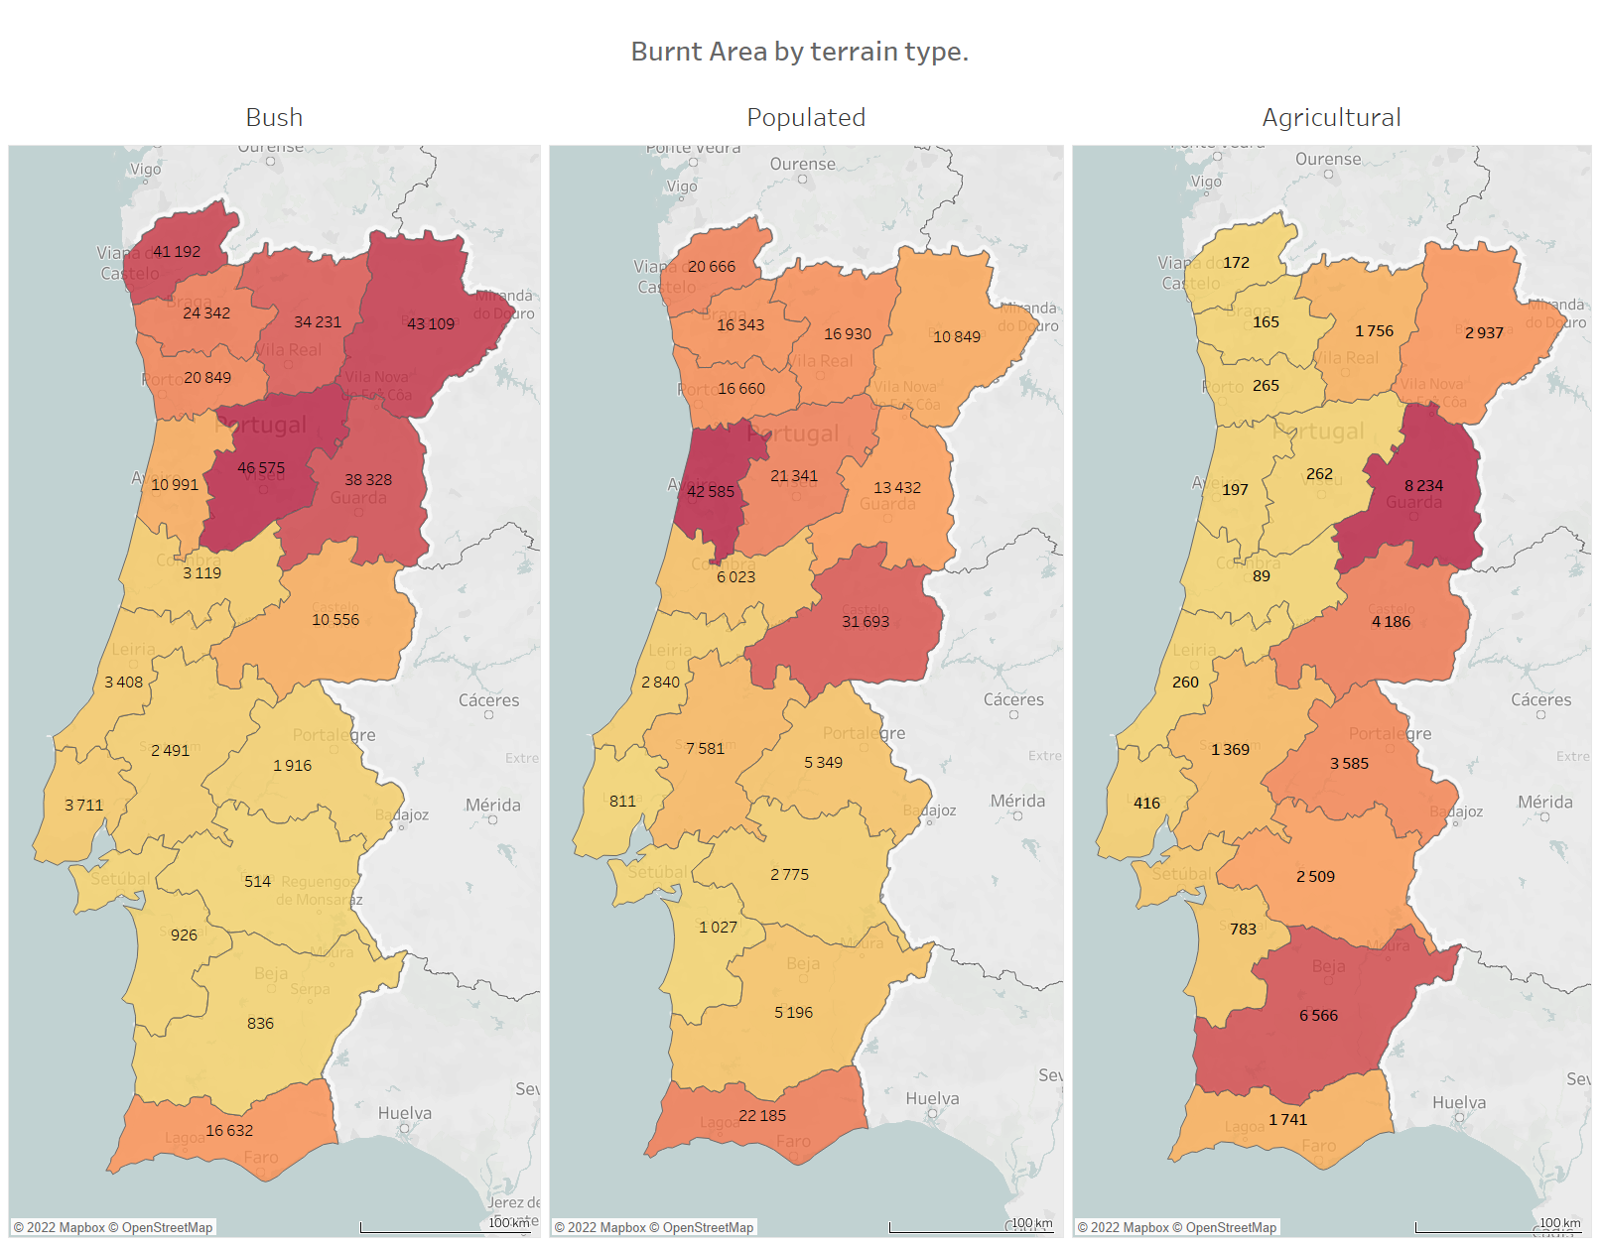
The macro view Portugal
Diferent types of terrain have their own hot spots.

Slide 4
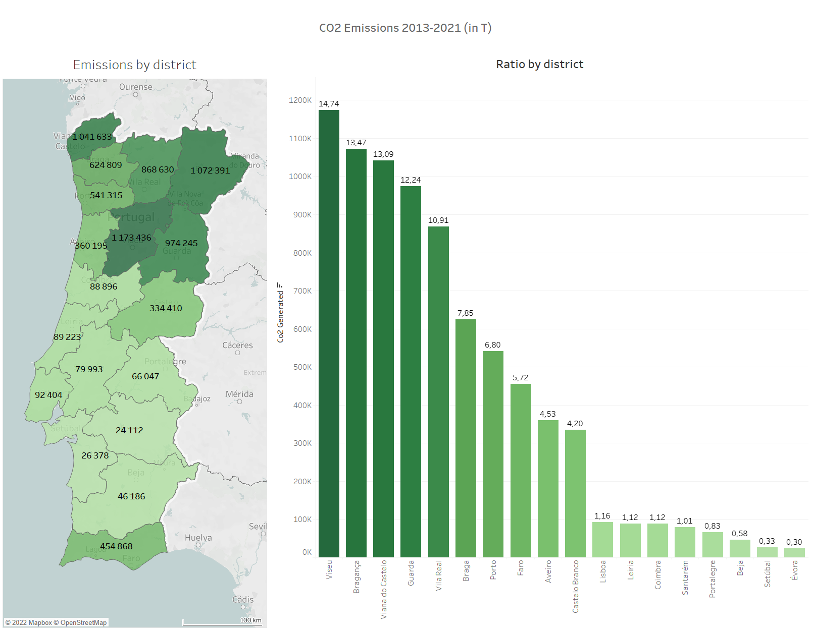
Is the burnt area a good metric?
A lot of factors come into play, but the emissions generated by the fires are actually the biggest problem as they affect the quality of the air.
CO2 calculation method:
X(t) = (bush_area* bush_area_fuel_coeficient + populated_area* populated _area_fuel_coeficient + agricultural_area* agricultural_area_fuel_coeficient)*Emission_Factor
In: Tiago Silva, José Pereira, José Paúl, Maria Santos, Maria vasconcelos – Estimativa de emissões Atmosféricas de fogos rurais em Portugal

Slide 5
12 989 826
A scary number

Slide 6
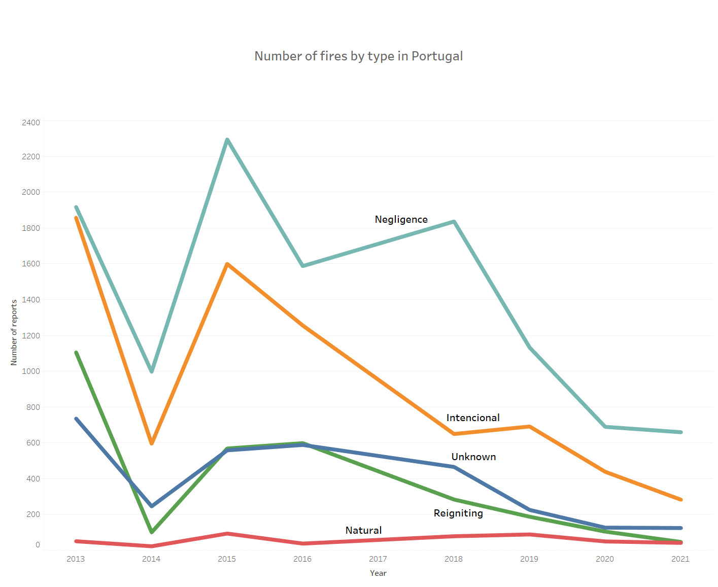
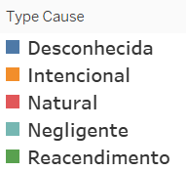
Are natural fires relevant?
No, they are not, but we can look deeper and see interesting regional results as:
Negligent fire is a problem in Portugal.
The number of fires is actually decreasing.

Slide 7
Do we have data to predict the burnt area?

Slide 8





WE DO!
GPS DATA
Fire Weather
Index System
TIME STAMPS

Slide 9
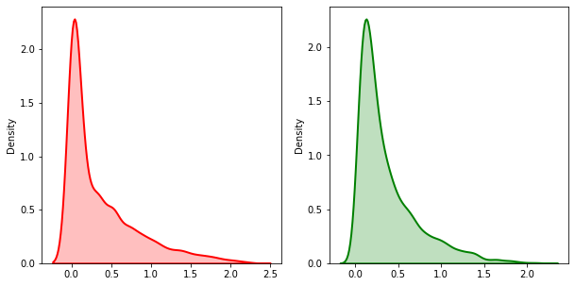
WE DO!
Since 2013 the observed weather in the day of the fire is recorded into a dataset.
The original data can’t be used without real cleaning, if a model is built arround this data it will completly skew the reality.
The data input is for sure one of the things that should be improved since the impact is big on everything from simple plots to prediction models.
Real Results Model results
Total Burned area real: 10106.52
Total Burned area predicted: 9640.48
95% of the real data

Slide 10
Another look
We can clearly see that some districts have almost exclusively intencional fires, and others just negligence realted ones.
Better prevention and fires enforcement rules have to be in place for the negligence related districts since they are mostly agricultural.

Slide 11
Full research and project at GitHub
github.com/Simao-Lopes/Fire-Project

Slide 12
Sources
Nuzulul Khairu Nissa, The Experiment of Forest Fires Prediction using Deep Learning -https://medium.com/mlearning-ai/the-experiment-of-forest-fires-prediction-using-deep-learning-d537e8c8e3a2
Fire Weather Index (FWI) System - https://www.nwcg.gov/publications/pms437/cffdrs/fire-weather-index-system
Jorge Miguel Gomes, A repository for ICNF data - https://github.com/vostpt/ICNF_DATA
Paulo Cortez & Anibal Morais, A Data Mining Approach to Predict Forest Fires using Meteorological Data
Joana da Fonseca Valente, Modelação do fogo florestal e os seus impactes na qualidade do ar.

